Slide 1


SQL Saturday Baton Rouge 2025
Global and Facility Sponsors

Slide 2




SQL Saturday Baton Rouge 2025
Platinum Sponsors

Slide 3






Slide 4






Slide 5


Slide 6

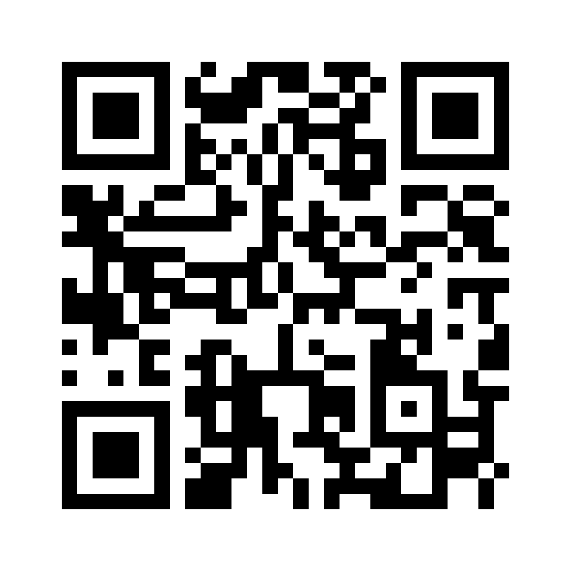

Please complete your session evaluations

Slide 17


